Slide 1
Group discussions

Slide 2
Announcement
Please keep a pen and a notebook with you.
Make notes of the important points of the lecture.

Slide 3
Topics to discuss
Stages of group development
Understanding Discussions, advantages, objectives, types, features, Roles, skills needed
Identifying successful discussion techniques
Conducting effective group discussions
Importance of body language
Academic discussions.

Slide 4
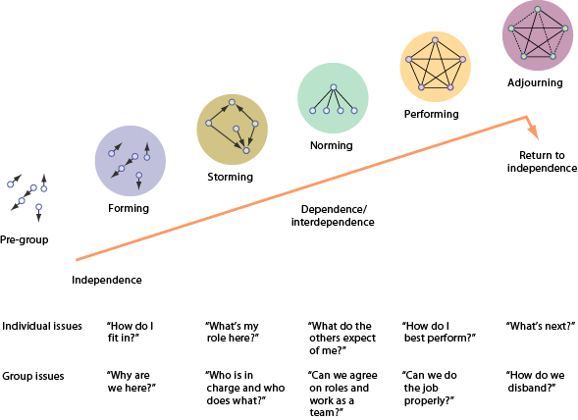
Five Stages of Group Development

Slide 5
Stages of Team Development
Stage
Major Processes
Characteristics
1. Forming (orientation)
2. Storming (conflict)
3. Norming (cohesion)
Exchange of information; increased interdependency; task exploration; identification of commonalties
Disagreement over procedures; expression of dissatisfaction; emotional responses; resistance- ego.
Growth of cohesiveness and unity; establishment of roles, standards, and relationships
Tentative interactions; polite discourse; concern over ambiguity; self-discourse
Criticism of ideas; poor participation; hostility; polarization and coalition forming, conflicts.
Agreement on procedures; reduction in role ambiguity; increased "we-feeling"
Notes:
(http://lowery.tamu.edu/teaming/morgan1/index.htm)

Slide 6
Stages of Team Development (continued)
Stage
Major Processes
Characteristics
4. Performing (performance)
5. Adjourning (dissolution)
Goal achievement; high task orientation; emphasis on performance and production
Termination of roles; completion of tasks; reduction of dependency
Decision making; problem solving; mutual cooperation
Disintegration and withdrawal; increased independence and emotionality; regret
Notes:
(http://lowery.tamu.edu/teaming/morgan1/index.htm)

Slide 7
Code of Cooperation
Should be developed, adopted, improved or modified by all team members.
Should always be visible to team members.
Sets a norm for behavior (Code of Ethics for your team)
Notes:
(http://lowery.tamu.edu/teaming/morgan1/index.htm)

Slide 8
Techniques to lead a team towards success.
Forming to storming | Storming to Norming | Norming to performing
Establish and communicate the mission Set goals Identify roles Build trust Leader must direct and assert position Bring the team together on a regular basis to work on joint projects | Set expectations and expect to deliver results Support positive behavior Create a positive environment Achievements must be recognized and celebrated Respect and listen to each other Recognize individuals’ roles and expertise Everyone works to create a supportive environment Feedback is requested, accepted and acted upon. | Praise each other Share responsibility Delegate freely Communicate and keep every member up-to-date Share success Commit time to the team Evaluate their performance and strive to achieve more challenging objectives Share leadership based upon individual skills sets Be selective when recruiting new team members Work to maintain team spirit.

Slide 9
Common Teaming Problems
Lack of commitment
Dominating participants
Reluctant participants
Unquestioned acceptance of opinions as facts
Rush to accomplishment
Attribution
Wanderlust: (departure from the subject)
Feuding members
From Scholtes, Peter R., The Team Handbook, Joiner Associates (1988)
Notes:
(http://lowery.tamu.edu/teaming/morgan1/index.htm)

Slide 10
Five Issues to be Considered in Team Building
Interdependence: Consider how individual and collective actions lead to optimal outcomes. Team task should be such that it requires cooperative interdependence.
Goal Specification: Develop mission and goals statement, individual and common goals for team achievement and communicate properly.
Cohesiveness- Attractiveness of team membership. Unity.
Social cohesiveness: Bonds of interpersonal attraction that link team members resulting a pleasant team life.
Task cohesiveness: Refers to the way in which skills and abilities of the team members mesh to allow effective performance.
Notes:
(http://lowery.tamu.edu/teaming/morgan1/index.htm)

Slide 11
Five Issues to be Considered in Team Building
Roles and Norms: The assignment of roles to members who can perform them effectively, the understanding and acceptance of the norms governing the assignment of roles by team members is essential.
Norms include the rewards for upholding as well as the sanctions for norm violations.
Communication- Develop an effective communication network; who communicates to whom; is there anybody “out of the loop?”
Practice:
Active listening exercises
Giving and receiving feedback
Checking for comprehension of verbal messages.
Notes:
(http://lowery.tamu.edu/teaming/morgan1/index.htm)

Slide 12
Group discussion

Slide 13
Definition.
Definitions vary.
Generally, It is a systematic and purposeful interactive oral process. Here the exchange of ideas, thoughts and feelings, in a systematic and structured way, take place through oral communication.
An effective group discussion is one in which the group is able to accomplish its purpose or to establish a basis either for ongoing discussion or for further contact and collaboration among its members.
In this form of communication, a particular number of people meet face to face and through free oral interaction, originate, share, and discuss ideas to arrive at a decision or solution to a problem.

Slide 14
What is an Academic Conversation/discussion?
An academic conversation goes beyond casual conversation/discussion. The goal is for the participants to reach a new understanding of a school topic through the use of specific conversational skills ( Listen actively, appraise, synthesize, evaluate, recommend, interpret, compare, etc.). Each partner must listen and speak, elaborate, clarify, challenge, paraphrase, and summarize what his/her partner says, and determine the outcome of the conversation.

Slide 15
G.D. As a Tool.
Group discussions are widely used in many organizations for decision making and problem solving.
It is used as a tool for the selection of candidates for jobs and academic courses

Slide 16
Phases in a Group Discussions:
1. Initiation/introduction- Stating and understanding purpose, attention grabber, making proposal, stating time limits. Relationship of knowledge with old and future knowledge.
2. The central group discussion – Questions about topic, Supporting your argument, critically analyzing, evaluating and comparing arguments. PRESENTER- reroutes the thinking, questions, controls.
3. Summarization/conclusion- Reviewing, deciding on rejecting and accepting arguments. Coming to the unanimous decisions, recorded conclusions.

Slide 17

Five Roles That Build Task Accomplishment

Slide 18
The objectives of in GD
G-Generating Ideas
•R-Reviewing policies and plans
•O-Organizing teams/ tasks
•U-Understanding perspectives
•P-Problem solving
•D-Decision making
•I-Information exchange
•S-Strategic planning
•C-Conflict resolution
•U-Unity among people
•S-Studying cases
•S-Socializing people
•I-Instruction
•O-Oneness of group participants
•N-Negotiation

Slide 19
Possible uses for a group discussion:
It is mainly to check individuals` team playing skills.
Create a new situation – form a coalition, start an initiative, etc.
Explore cooperative or collaborative arrangements among groups or organizations.
Discuss and/or analyze an issue.
Create a strategic plan – for an initiative, an advocacy campaign, an intervention, etc.
Discuss policy and policy change.
Notes:
19

Slide 20
Possible uses for a group discussion (cont.):
Highlight concerns and differences among individuals or groups.
Hold public hearings on proposed laws or regulations, development, etc.
Decide on an action.
Provide mutual support.
Solve a problem.
Resolve a conflict.
Plan a project/work or an event.
Notes:
20

Slide 21
Characteristics of Group discussions.
Interaction: All have a chance to speak, expressing their own ideas and feelings freely, and to pursue and finish out their thoughts.
Leader and members: leader summarizes fact and information, integrates and stimulates thinking and agrees to unified solution. While members have relative roles.
Participation and interpersonal interaction becomes visible.
Pressure to conform: pre-defined and established standards.
Conflicts: due to political Behaviour, dysfunctional consequences, sometimes stimulates new solutions to the problems.

Slide 22
Advantages of group discussions

Slide 23
Organization of group discussions.
TWO WAYS OF ORGANIZING A DISCUSSION
A topic is given in advance and participants are expected to come prepared for the discussion.
In other case, the topic is disclosed to the participants after they have assembled and they are given about 10 minutes to think about it.

Slide 24
Classification of group discussions.

Slide 25
Types of group discussions
Based on conduct, there are four major types.
Structured GD: A topic and time-frame is already decided and provided. Everyone has a decided role to play.
Unstructured GD: Here the candidates themselves decide the topic with mutual consent.
Role Play: Candidates are given a situation in which they have to perform different roles while solving the problem inherent in the situation.
GD with a nominated leader: The leader as a facilitator summarizes and guides the participants from the start till the end of it.

Slide 26
Types of group discussions
Based on topic, there are three types of GD.
Conversational topics GD: A topic, lively arguments and counter arguments, opportunities to evaluate. i.e. Should cloning be allowed?
Abstract Topic GD: Vague or unclear topic, personal opinions, evaluation of creative ability of the candidates. i.e. “ one and one make eleven.”
Case study topic GD: Situations with problems, faced by organizations or managers are given, candidates analyze and find alternative solutions, evaluation of situation analysis and decision making.

Slide 27
Roles in a Structured GD:
• Presenter/Leader
• Initiator
• Information seeker and giver
• Procedure facilitator
• Opinion seeker/giver
• Clarifier/adviser
• Summarizer/assessor
• Social supporter
• Harmonizer/linker
• Tension reliever
• Recorder
• Attacker/Dominator
Encourager
Devil’s advocate.
Harmonizing, compromising, encouraging and gatekeeping build and maintain teams.

Slide 28
Some people leading a group discussion:
Directors of organizations
Public officials
Coalition coordinators
Professionals with group-leading skills
Teachers
Health professionals and health educators
Respected community members
Community activists
Notes:
28

Slide 29
Skills Needed for G.D. (Evaluation Grid)
Subject Knowledge:
Communication Skills:
Positive personality:
Interpersonal Skills:
Group Behavior:
Leadership Skills:

Slide 30
Skills Needed for G.D. (Evaluation Grid)
Subject Knowledge: Thorough understanding, originality, confident, enthusiastic. Otherwise, monotony and repetition.
Communication Skills: verbal and nonverbal, Logical and clear ideas and opinions, oratory skills/spoken, sound vocabulary, listening receptively.
Positive personality: external and traits, dressing, attitude, style of presentation, positive and critical eye, problem solving,.( 25 to 30 minutes to make an impression)

Slide 31
Skills Needed for G.D. (Evaluation Grid)
4. Interpersonal Skills: People centric, objective, empathize, cooperation, coordination, harmony, acceptance, controlling but not dominating.
5. Group Behavior: It`s reflected in interaction, control on temper, positive, mature, patient, balanced, multiple roles, silent spectator, get the opinion endorsed by others, appreciative.
6. Leadership Skills: Natural leader, Assertiveness, emotional stability, objectivity, self-confidence, decision making, discretion, initiative, patience, inspire, persuasiveness and adaptability , neither be very authoritative nor submissive but must be democratic.

Slide 32
Listening Techniques
Critical Listening
Separate fact from opinion.
Sympathetic Listening
Don't talk - listen.
Don't give advice - listen.
Don't judge - listen.
Creative Listening
Exercise an open mind.
Supplement your ideas with another person's ideas and vice versa.
Notes:
(http://lowery.tamu.edu/teaming/morgan1/index.htm)

Slide 33
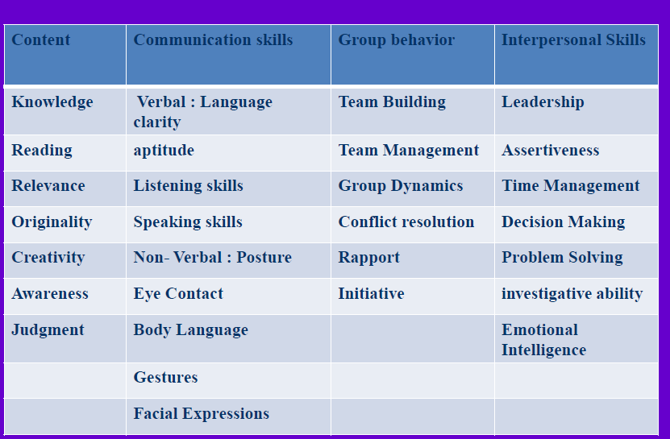
G.D. INGRIDIENTS, SUB-ELEMENTS AND TECHNIQUES OF IMPROVEMENT.

Slide 34
Non-verbal messages.

Slide 35
Successful G.D. Techniques-Do`s and Don'ts.
Organize your thoughts, plan, repeat and speak.
Evaluate what you hear. Silently introspect and record.
Be who you are. As neutral as possible. Seek clarifications.
Be assertive without being authoritative or aggressive.
Simple formal language and enthusiastic posture.
Befriend with the ignored ones.
Be clear and fluent.
No personal offence, no strong phrases.

Slide 36
Successful G.D. Techniques-Do`s and Don'ts.
9. Model the behavior and attitudes you want group members to employ.
10. Use encouraging body language and tone and words.
11. Give positive feedback. Ask open-ended questions.
12. Be aware of people’s reactions and feelings, and try to respond appropriately.
13. Control your own biases.
14. Encourage disagreement, and help the group use it creatively.
Notes:
36

Slide 37
Successful G.D. Techniques-Do`s and Don'ts.
Don`t listen to contradict, but to construct. Don’t impose.
Don’t let one or a small group of individuals dominate the discussion.
Don’t let one point of view override others.
Don’t assume that anyone is privileged and holds particular opinions or positions due to his culture, background, race etc.
Don’t be the font of all wisdom. Don`t interrupt.
Notes:
37

Slide 38
Qualities of a successful G.D. participant.

Slide 39
Qualities of a successful G.D. participant.

Slide 40
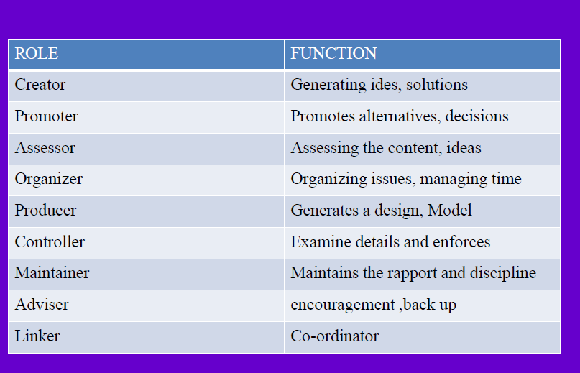
Roles and functions of group members.

Slide 41
Group Development Activity
Trace the development of a group you once belonged to (For example, group development for the final project).
Make note of the extent to which the group experienced
(a) an orientation stage,
(b) conflict,
(c) increased cohesion and changes in structure,
(d) a period of high performance.
Read the two theories discussed in the book--Tuckman's stage model or Bale's equilibrium model.

Slide 42
Task. Discussion
Group A.
A certain period of practical, social and professional work should be required for all students, who apply to college.
Group B
Students who apply to college should not do any practical, social and professional work for many reasons, during this invaluable education taking period.
The discussion will be observed in the parameters: Knowledge level, ability to take initiative, listening skill, cooperation, creation, 0rganization and delivery of genuine ideas, body language.

Slide 43
Is feminism irrelevant in the 21st century?
The harms of patriotism outweigh the benefits.
The development of artificial intelligence: harmful or beneficial to humankind?
Can Religion And Science Coexist?

